Slide 1
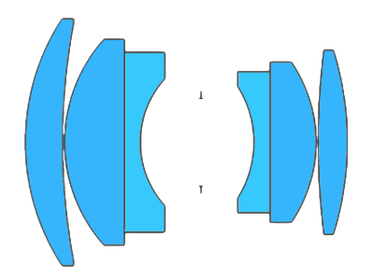
Depth of Field
Depth of Field
Depth of Field
Depth of Field
Depth of Field
DEEP OBJECT SPACE
Sensor
Sensor
Sensor
Sensor
Sensor
Plane of sharp focus
Plane of sharp focus
Plane of sharp focus
Plane of sharp focus
Plane of sharp focus

Slide 2
Depth of Field
Sensor
Plane of sharp focus

Slide 3
Depth of Field
Sensor
Plane of sharp focus

Slide 4
Depth of Field
Sensor
Plane of sharp focus

Slide 5
Depth of Field
Sensor
Plane of sharp focus

Slide 6
Depth of Field
Sensor
Plane of sharp focus

Slide 8
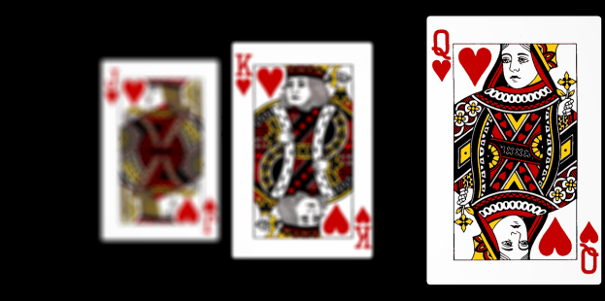
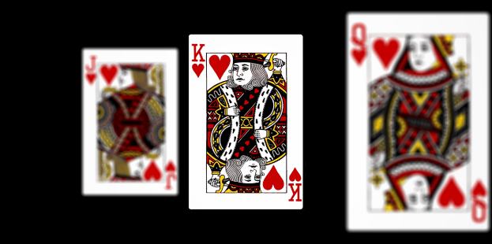



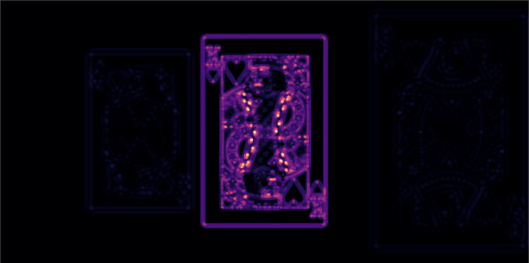
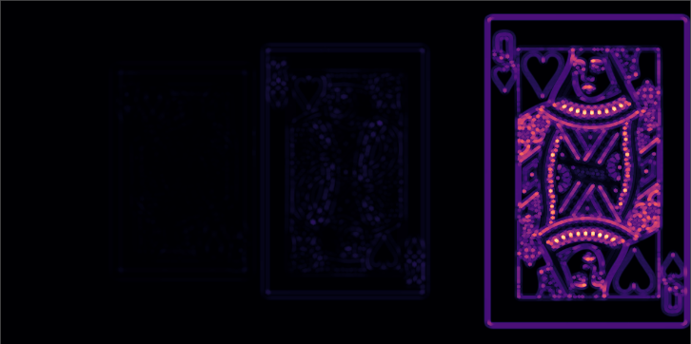

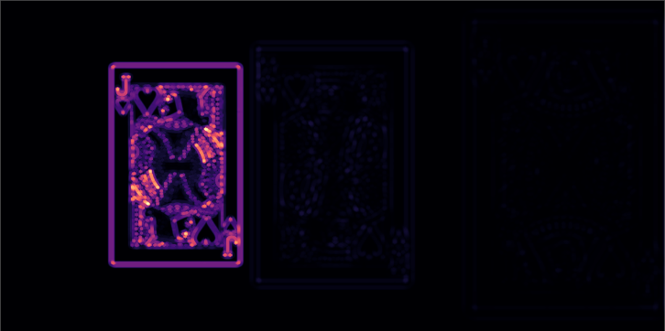
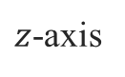
Sensor image 1/3
Sensor image 2/3
Sensor image 3/3
Lens
64 mm
$z$-axis
Sensor plane
Focus measure (LoG)
Focus measure (LoG)
89 mm
200 mm
Focus measure (LoG)
200 mm
1000 mm

Slide 10
Sensor image 1/3
Focus measure (LoG)

Slide 11
Sensor image 2/3
Focus measure (LoG)

Slide 12
Sensor image 3/3
Focus measure (LoG)

Slide 13
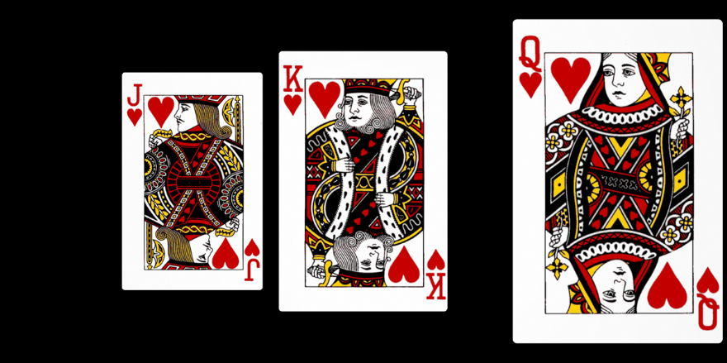
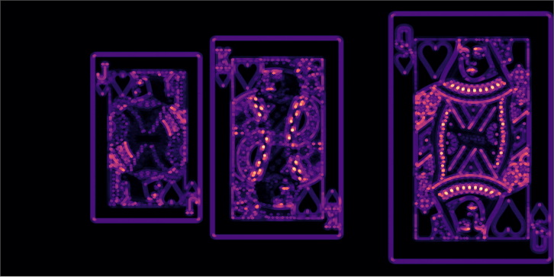
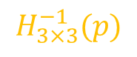
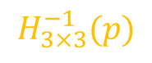
Registration
Blending
Composite image
1/2
$$H_{3×3}^{−1}(p)$$
1/2
$$H_{3×3}^{−1}(p)$$
Focus measure (LoG)

Slide 15
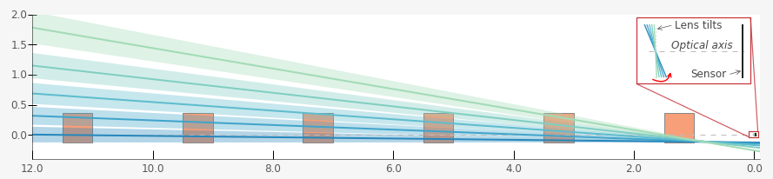
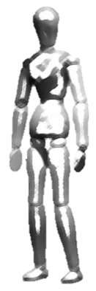
Plane of sharp focus
Plane of sharp focus
Plane of sharp focus
Plane of sharp focus
Plane of sharp focus
DEEP OBJECT SPACE
Sensor

Slide 16
Plane of sharp focus

Slide 17
Plane of sharp focus

Slide 18
Plane of sharp focus

Slide 19
Plane of sharp focus

Slide 20
Plane of sharp focus

Slide 21
Simulation

Slide 22
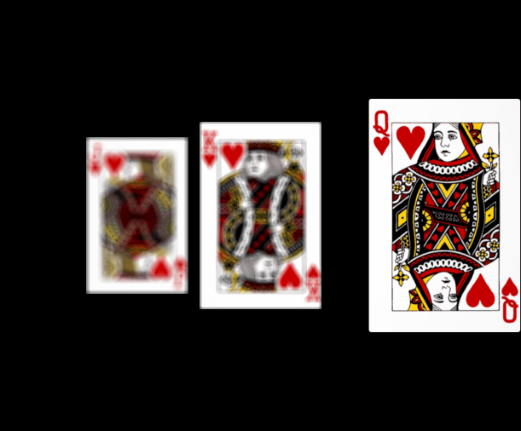
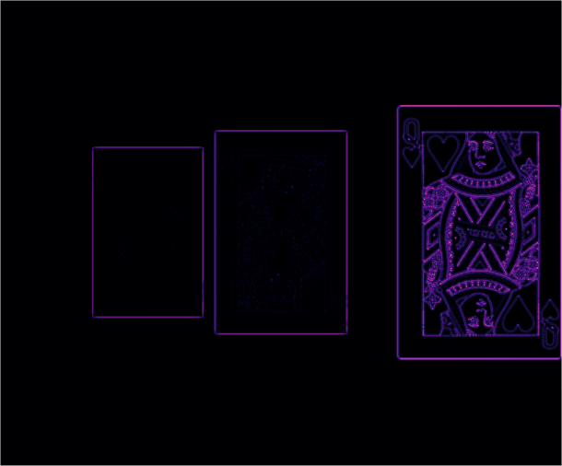
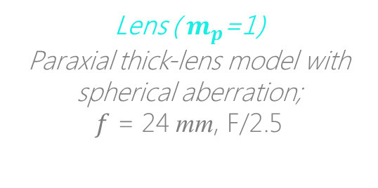


Simulation
Setup in Zemax
Sensor image 1/13 ( 0°)
Lens ( $m_{p}$=1)
Paraxial thick-lens model with spherical aberration;
$f$ = 24 mm, F/2.5
1/2
64 mm
$z$-axis
Sensor plane
6 x 5 sq. mm, 1.78 $μm$
89 mm
13 tilts
between -8° & +8°
200 mm
1/2
200 mm
1000 mm
Focus measure (LoG)

Slide 23
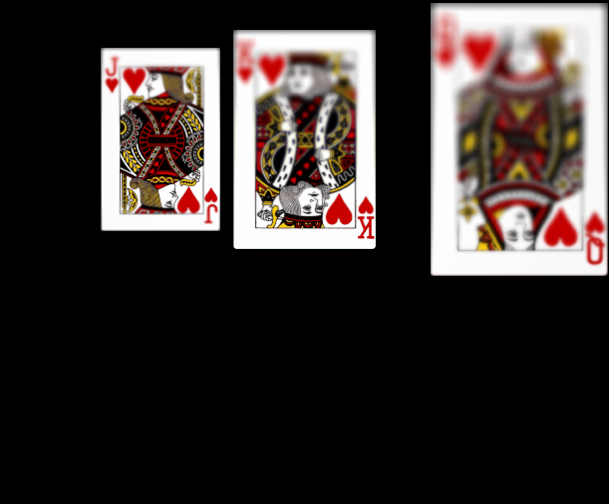
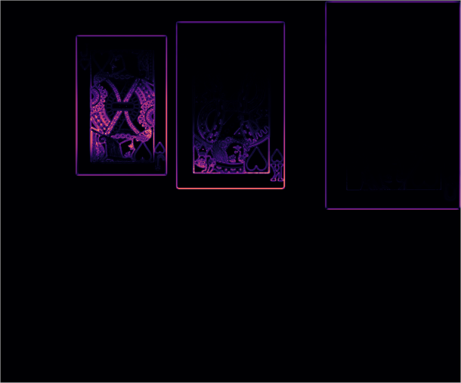

Simulation
Lens rotated by -$α$° about ENPP
Sensor image 7/13 (-8°)
Lens ( $m_{p}$=1)
Paraxial thick-lens model with spherical aberration;
$f$ = 24 mm, F/2.5
1/2
64 mm
$z$-axis
Sensor plane
6 x 5 sq. mm, 1.78 $μm$
89 mm
13 tilts
between -8° & +8°
200 mm
1/2
200 mm
1000 mm
Focus measure (LoG)

Slide 24
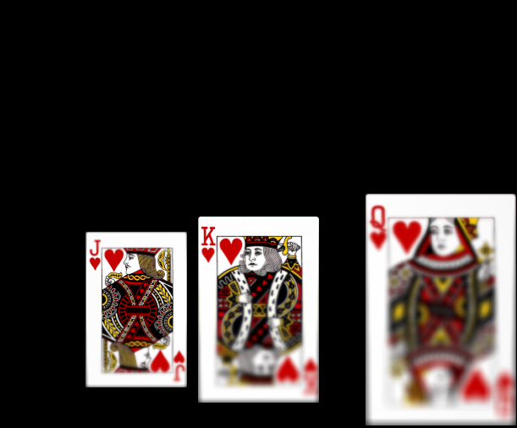
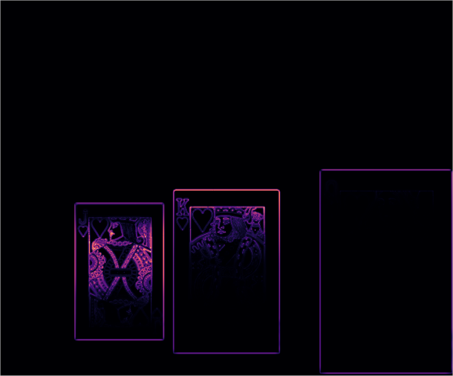

Simulation
Lens rotated by $α$° about ENPP
Sensor image 13/13 (8°)
Lens ( $m_{p}$=1)
Paraxial thick-lens model with spherical aberration;
$f$ = 24 mm, F/2.5
1/2
64 mm
$z$-axis
Sensor plane
6 x 5 sq. mm, 1.78 $μm$
89 mm
13 tilts
between -8° & +8°
200 mm
1/2
200 mm
1000 mm
Focus measure (LoG)
Notes:
The lens is tilted in both clockwise and anticlockwise directions.

Slide 25
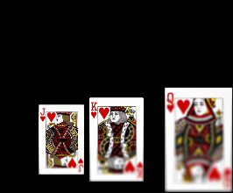
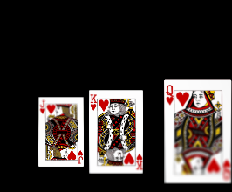
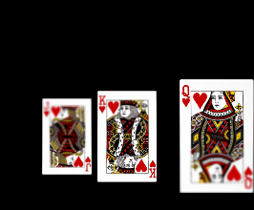
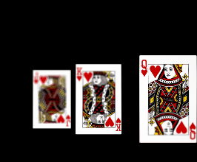
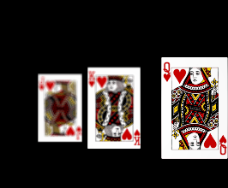
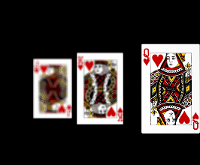
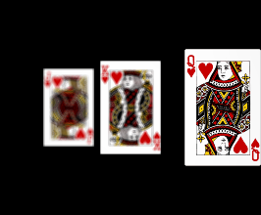
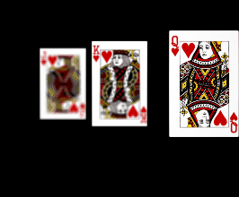
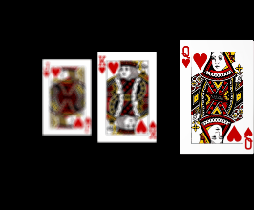
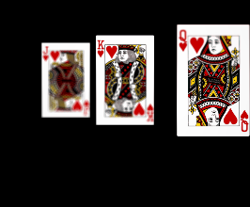
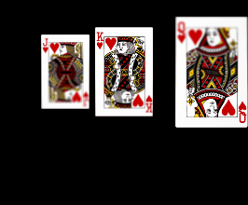
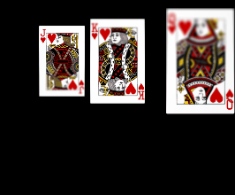

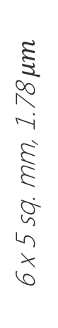

Simulation
Image stack
Lens ( $m_{p}$=1)
64 mm
$z$-axis
Sensor plane
6 x 5 sq. mm, 1.78 $μm$
89 mm
13 tilts
between -8° & +8°
200 mm
200 mm
1000 mm
Notes:
The stack contains 13 images obtained under uniform tilts of the lens between plus minus eight degrees.

Slide 26

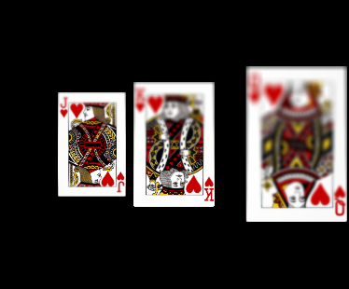
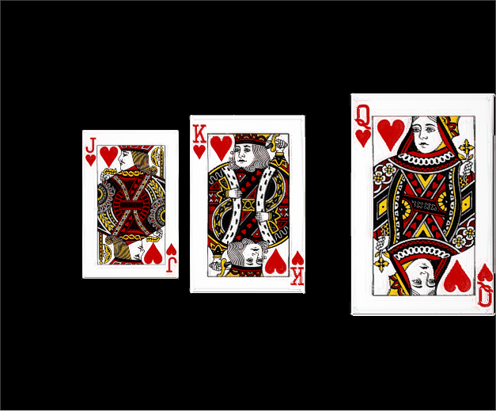
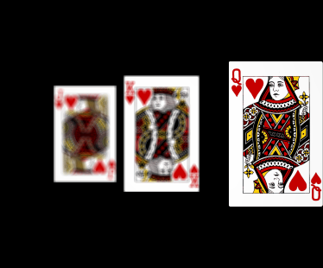
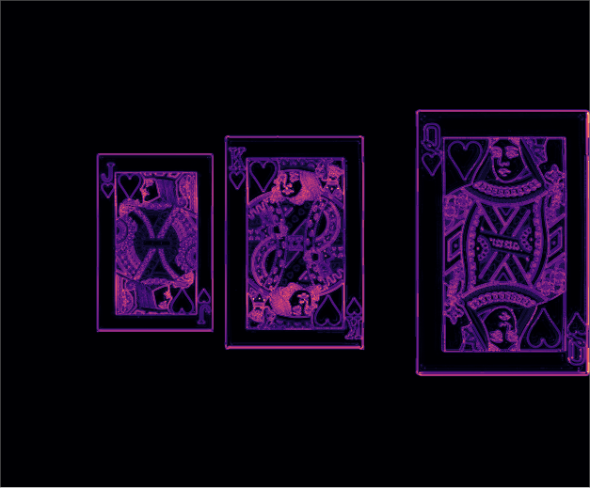

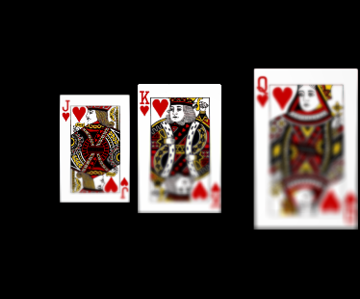




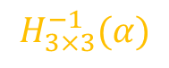
Simulation
Registration
Blending
Composite image
$$H_{3×3}^{−1}(α)$$
1/2
$$⋮$$
$$⋮$$
Focus measure (LoG)
$$⋮$$
$$⋮$$
1/2
$$H_{3×3}^{−1}(α)$$
Notes:
Based on our model of Scheimpflug imaging, we have derived a closed form expression of the inter-image homography that is used to register the images in the stack. Following registration, we create a composite image that contains all portions of the scene in focus.

Slide 27
Advantages and comparison
Simple if the pupil magnification of the lens is one.
Can be used to improve the depth of field of Scheimpflug cameras.
Notes:
Our method is simple and it can used to extend the depth of field of scheimpflug cameras.

